Slide 1


Image Simulations for Testing the Fidelity of SKYSURF Background Measurement Algorithms
Delondrae Carter, Haley Abate, Timothy Carleton

Slide 2
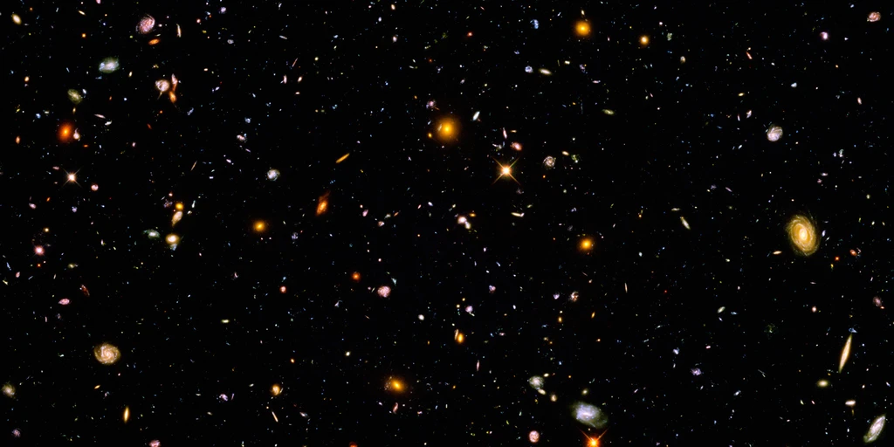
Project SKYSURF
Goal: Determine the Origins of the Light Received by Hubble
Hubble Ultra Deep Field (HUDF)
(Credit: NASA)

Slide 3
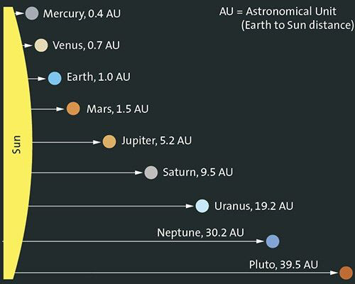
Why do we want to know where all the light is from?
95% of all light received by Hubble originates within 5 Astronomical Units (AU) of the Telescope.
Hubble can see out to 13 billion light years.
1 light year ≈ 63,000 AU, 1 AU ≈ 93 million miles
Understanding where the light is coming from will provide insight into cosmic star formation and planet formation.
(Credit: https://goformative.com/library/nJo52AaMmp4o2EmDf)

Slide 4
Motivation for Creating Image Simulations
Several sky background measurement algorithms have been developed to determine the background levels of images in the SKYSURF database.
To test the fidelity of these sky background measurement algorithms, images with known sky background and noise levels were necessary to determine quantitatively how far a sky background measurement algorithm strays from the true value.
For this purpose, I developed an algorithm that could create simulated images that emulate characteristics of filter F125W of the WFC3 IR instrument on the Hubble Space Telescope (HST).

Slide 5
Image Simulation Properties
The GALSIM Python package was used to create the simulated images.
All simulated images were produced to match the flat-fielded images produced by the WFC3 IR camera on Hubble: 1014 × 1014 pixels, with a 0.13”/pixel pixel scale.
When appropriate, parameters associated with the F125W filter were used (e.g. for galaxy/star counts and generating a PSF).

Slide 6
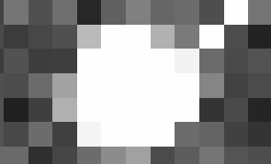
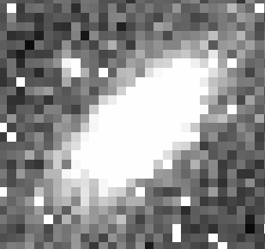
Simulating Stars and Galaxies
Stars and galaxies in the simulated images were created from mathematical models: a Gaussian light profile for stars, and an inclined Sersic profile for galaxies.
The number of stars and galaxies in each simulated image as a function of magnitude was taken from Windhorst et al. 2011:
  Nstars/(1.0 mag bin) = 1.0 × 10^[0.04(AB−18)], where Nstars/(1.0 mag bin) is the number of stars in a 1.0 magnitude bin in the WFC3 IR field of view, and AB is the AB magnitude of the star. (13 stars per image)
  Ngalaxies/(0.5 mag bin) = 1.0 × 10^[0.26(AB−18)], where Ngalaxies is the number of galaxies in a 0.5 magnitude bin in the WFC3 IR field of view. (624 galaxies per image)
Star magnitudes were restricted to 18 ≤ AB ≤ 26 to avoid unusually bright stars and stars below the F125W detection limit. For the same reason, galaxy magnitudes are restricted to 18 ≤ AB ≤ 26.5.

Slide 7
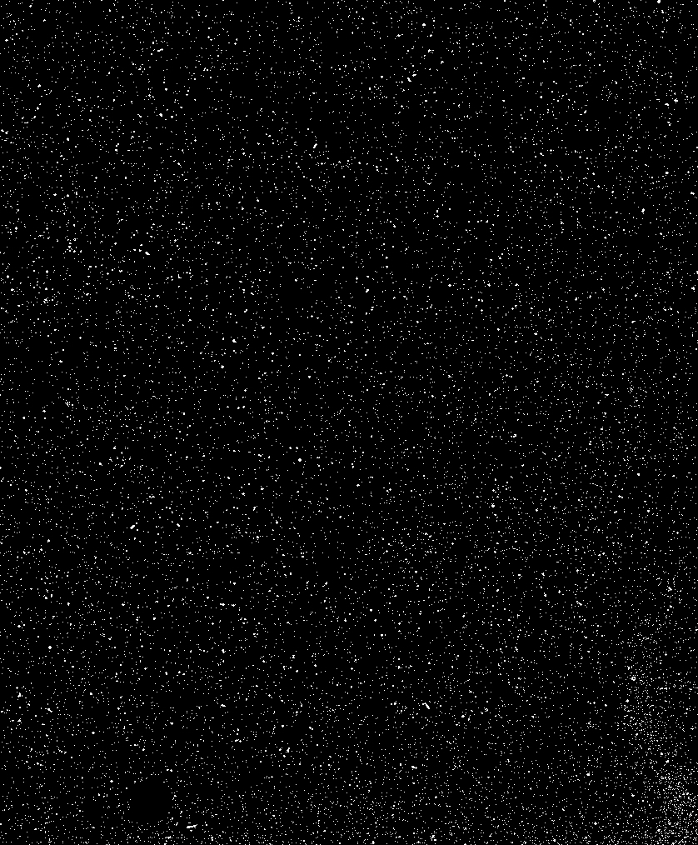
Noise Generation and Cosmic Rays
After all stars and galaxies were added to a simulated image, noise was generated for the simulated image with an RMS from the combination of Poisson noise and Gaussian read noise:
  RMS = sqrt([Ssky × t + (RN)^2]) / t, where Ssky is the sky background value, t is the exposure time, and RN is read noise (RN = 12 electrons for all images)
Cosmic rays were added to the simulated images from a cosmic ray template after noise generation. The number of cosmic rays in a simulated image is given by:
  NCRs = RCR×t, where NCRs is the number of cosmic rays in the simulated image, RCR is the cosmic ray rate of the cosmic ray template, and t is the exposure time of the simulated image.
  The cosmic ray template (displayed to the right) was generated by identifying spikes in the individual reads of image ibp309bxq_ima.fits. This resulted in a rate of 14.6 cosmic rays per second over the course of the 1302 second exposure.

Slide 8
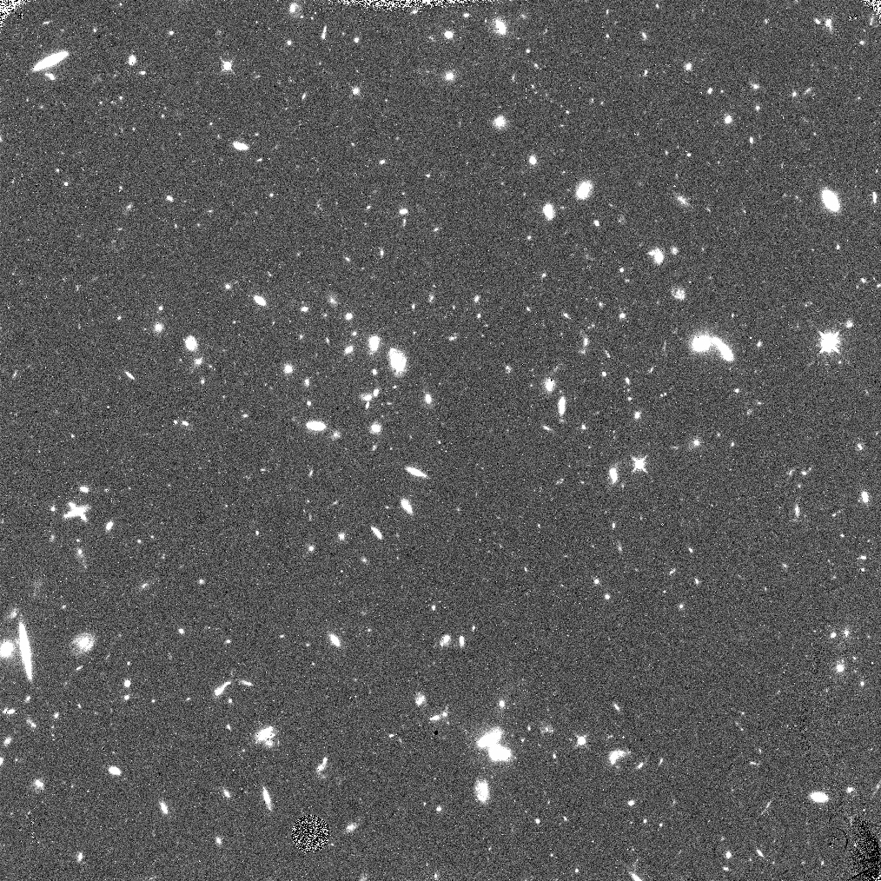
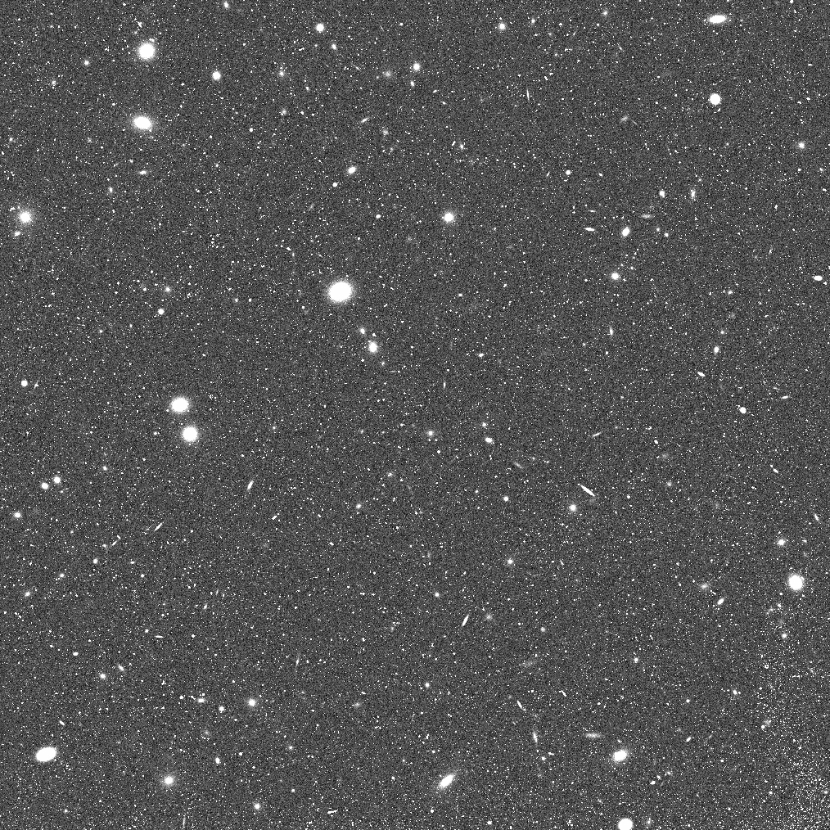
Putting it all Together
Real Image
Simulated Image

Slide 9
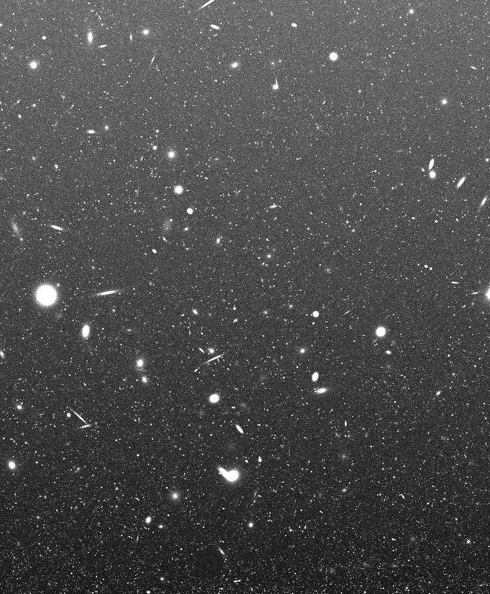
Last Step: Adding a Gradient
Real images often have a light gradient—a variation in pixel brightness from the bottom row to the top row.
To test the fidelity of sky measurement algorithms in such cases, a separate group of simulated images were produced with light gradients ranging from 1% to 20%.
The gradient in the simulated image displayed to the right is an extreme case (20% light variation from bottom to top).

Slide 10
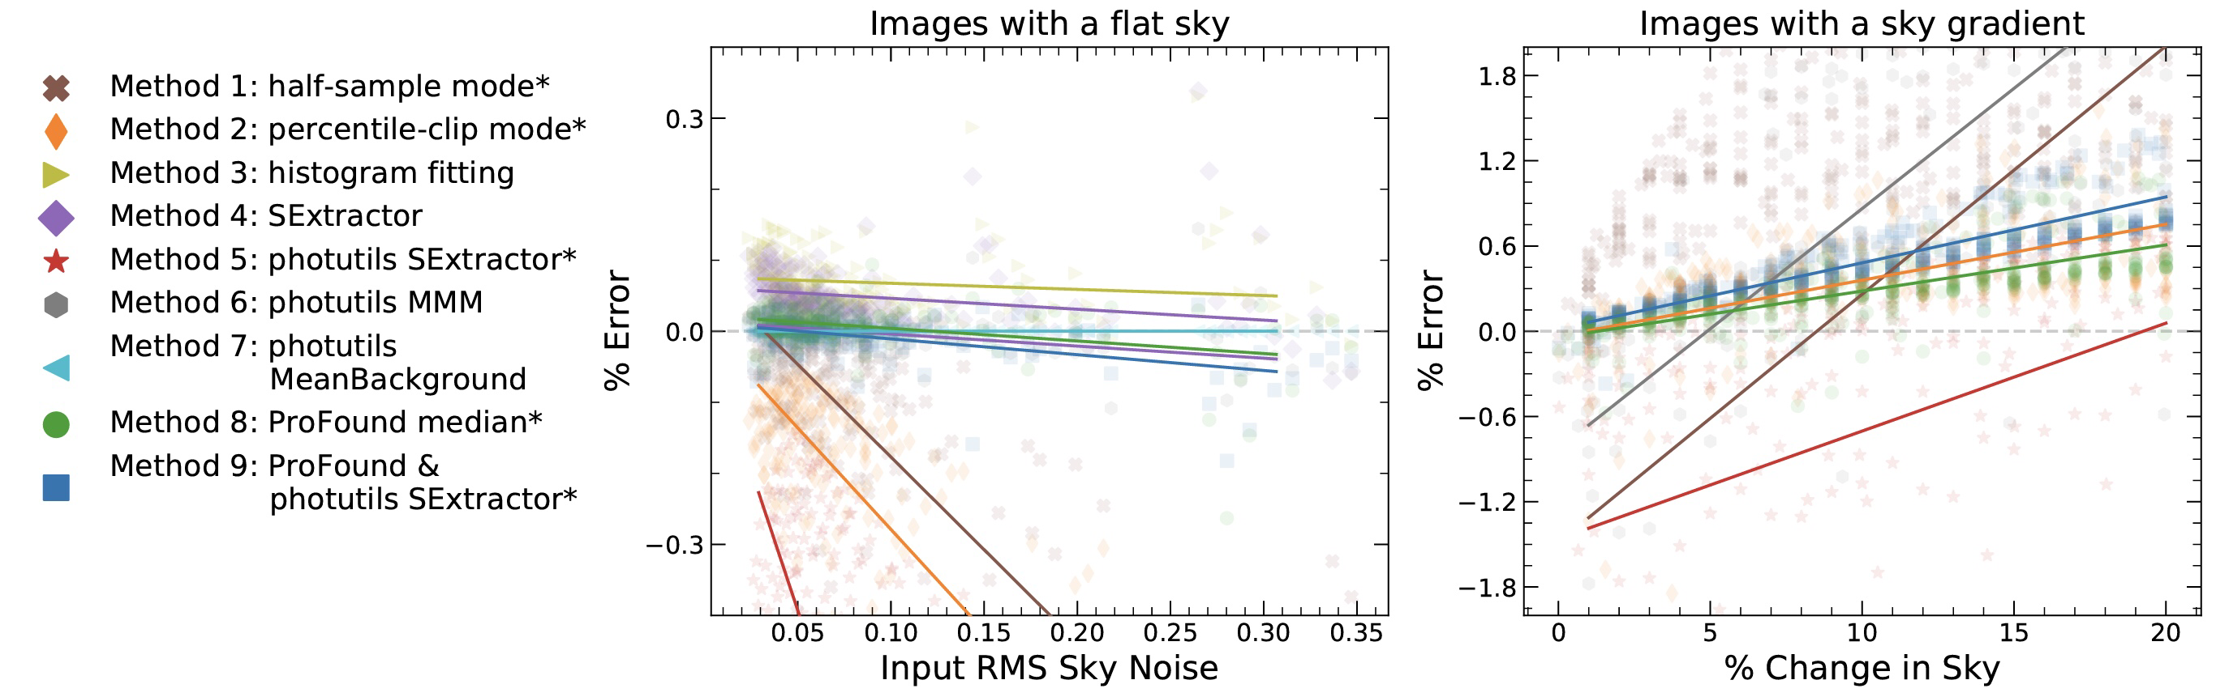
Sky Measurement Fidelity Testing Results
(Credit: Rosalia O’brien et al.)

Slide 11
Conclusions and Future Work
The sky measurement algorithms developed for project SKYSURF are incredibly precise, with many algorithms always measuring within 0.3% of the true value for non-gradient images and within 1.2% for gradient images.
Of the sky measurement algorithms, the photutils MeanBackground method is best for measuring images with a flat sky.
The ProFound median method is best for measuring images with gradients.
Now that we know we have excellent sky measurement algorithms, we can use the algorithms to measure the sky backgrounds of the real images in the SKYSURF database, the results of which will be used as input to the next step of project SKYSURF: image drizzling.

Slide 12
Acknowledgements
I would like to thank:
  Timothy Carleton: For supervising, directing, and quality checking my image simulation work.
  Haley Abate: For creating sets of non-gradient and gradient images containing galaxies with parameter inputs sampled from the 3D Hubble Space Telescope catalog (as opposed to mathematical models) and for creating simulated star cluster images.
  Rosalia O’Brien: For plotting the results of the sky measurement algorithm fidelity tests.
  ASU/NASA Space Grant Program: For funding my work.

Slide 13


Thanks for Listening! Questions?

